Slide 1

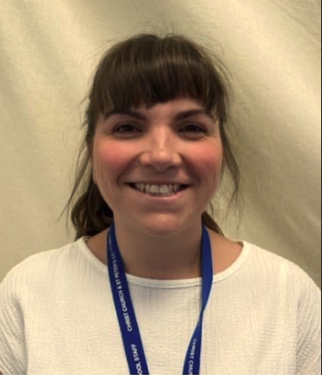
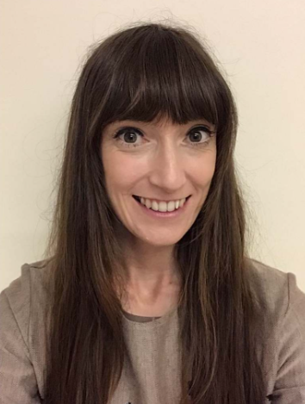
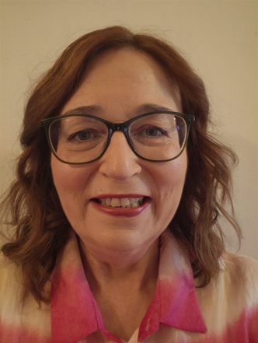
Staff you will see….
Miss Hogg
Goldfinch Class Teacher
Miss Holdich
Goldfinch Class Teacher
Miss Porter
Chaffinch class teacher and KS1 team leader

Slide 2
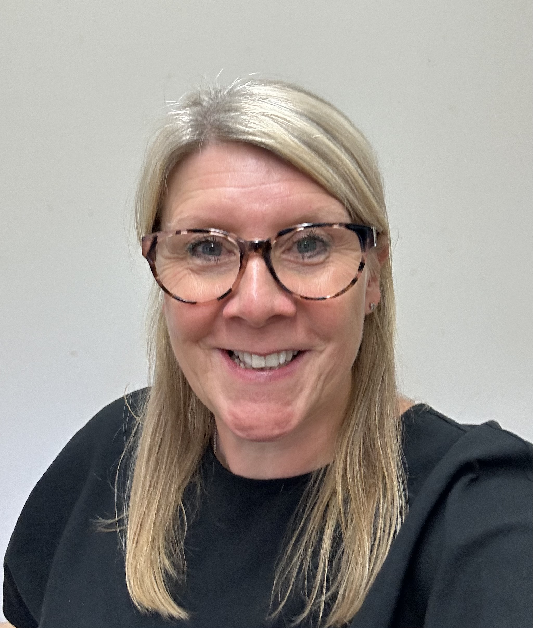
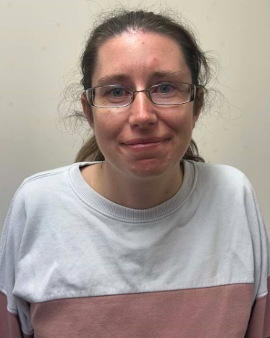
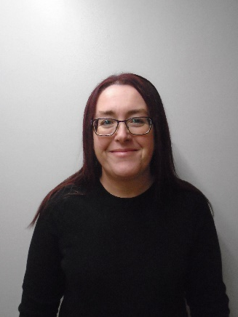
Staff you will see….
Mrs Crawley
Teaching assistant
Mrs Wardle
Learning Mentor
Miss Adkin
Assistant Learning Mentor

Slide 3
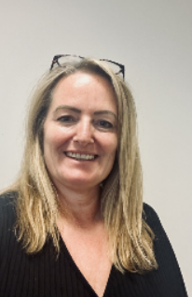

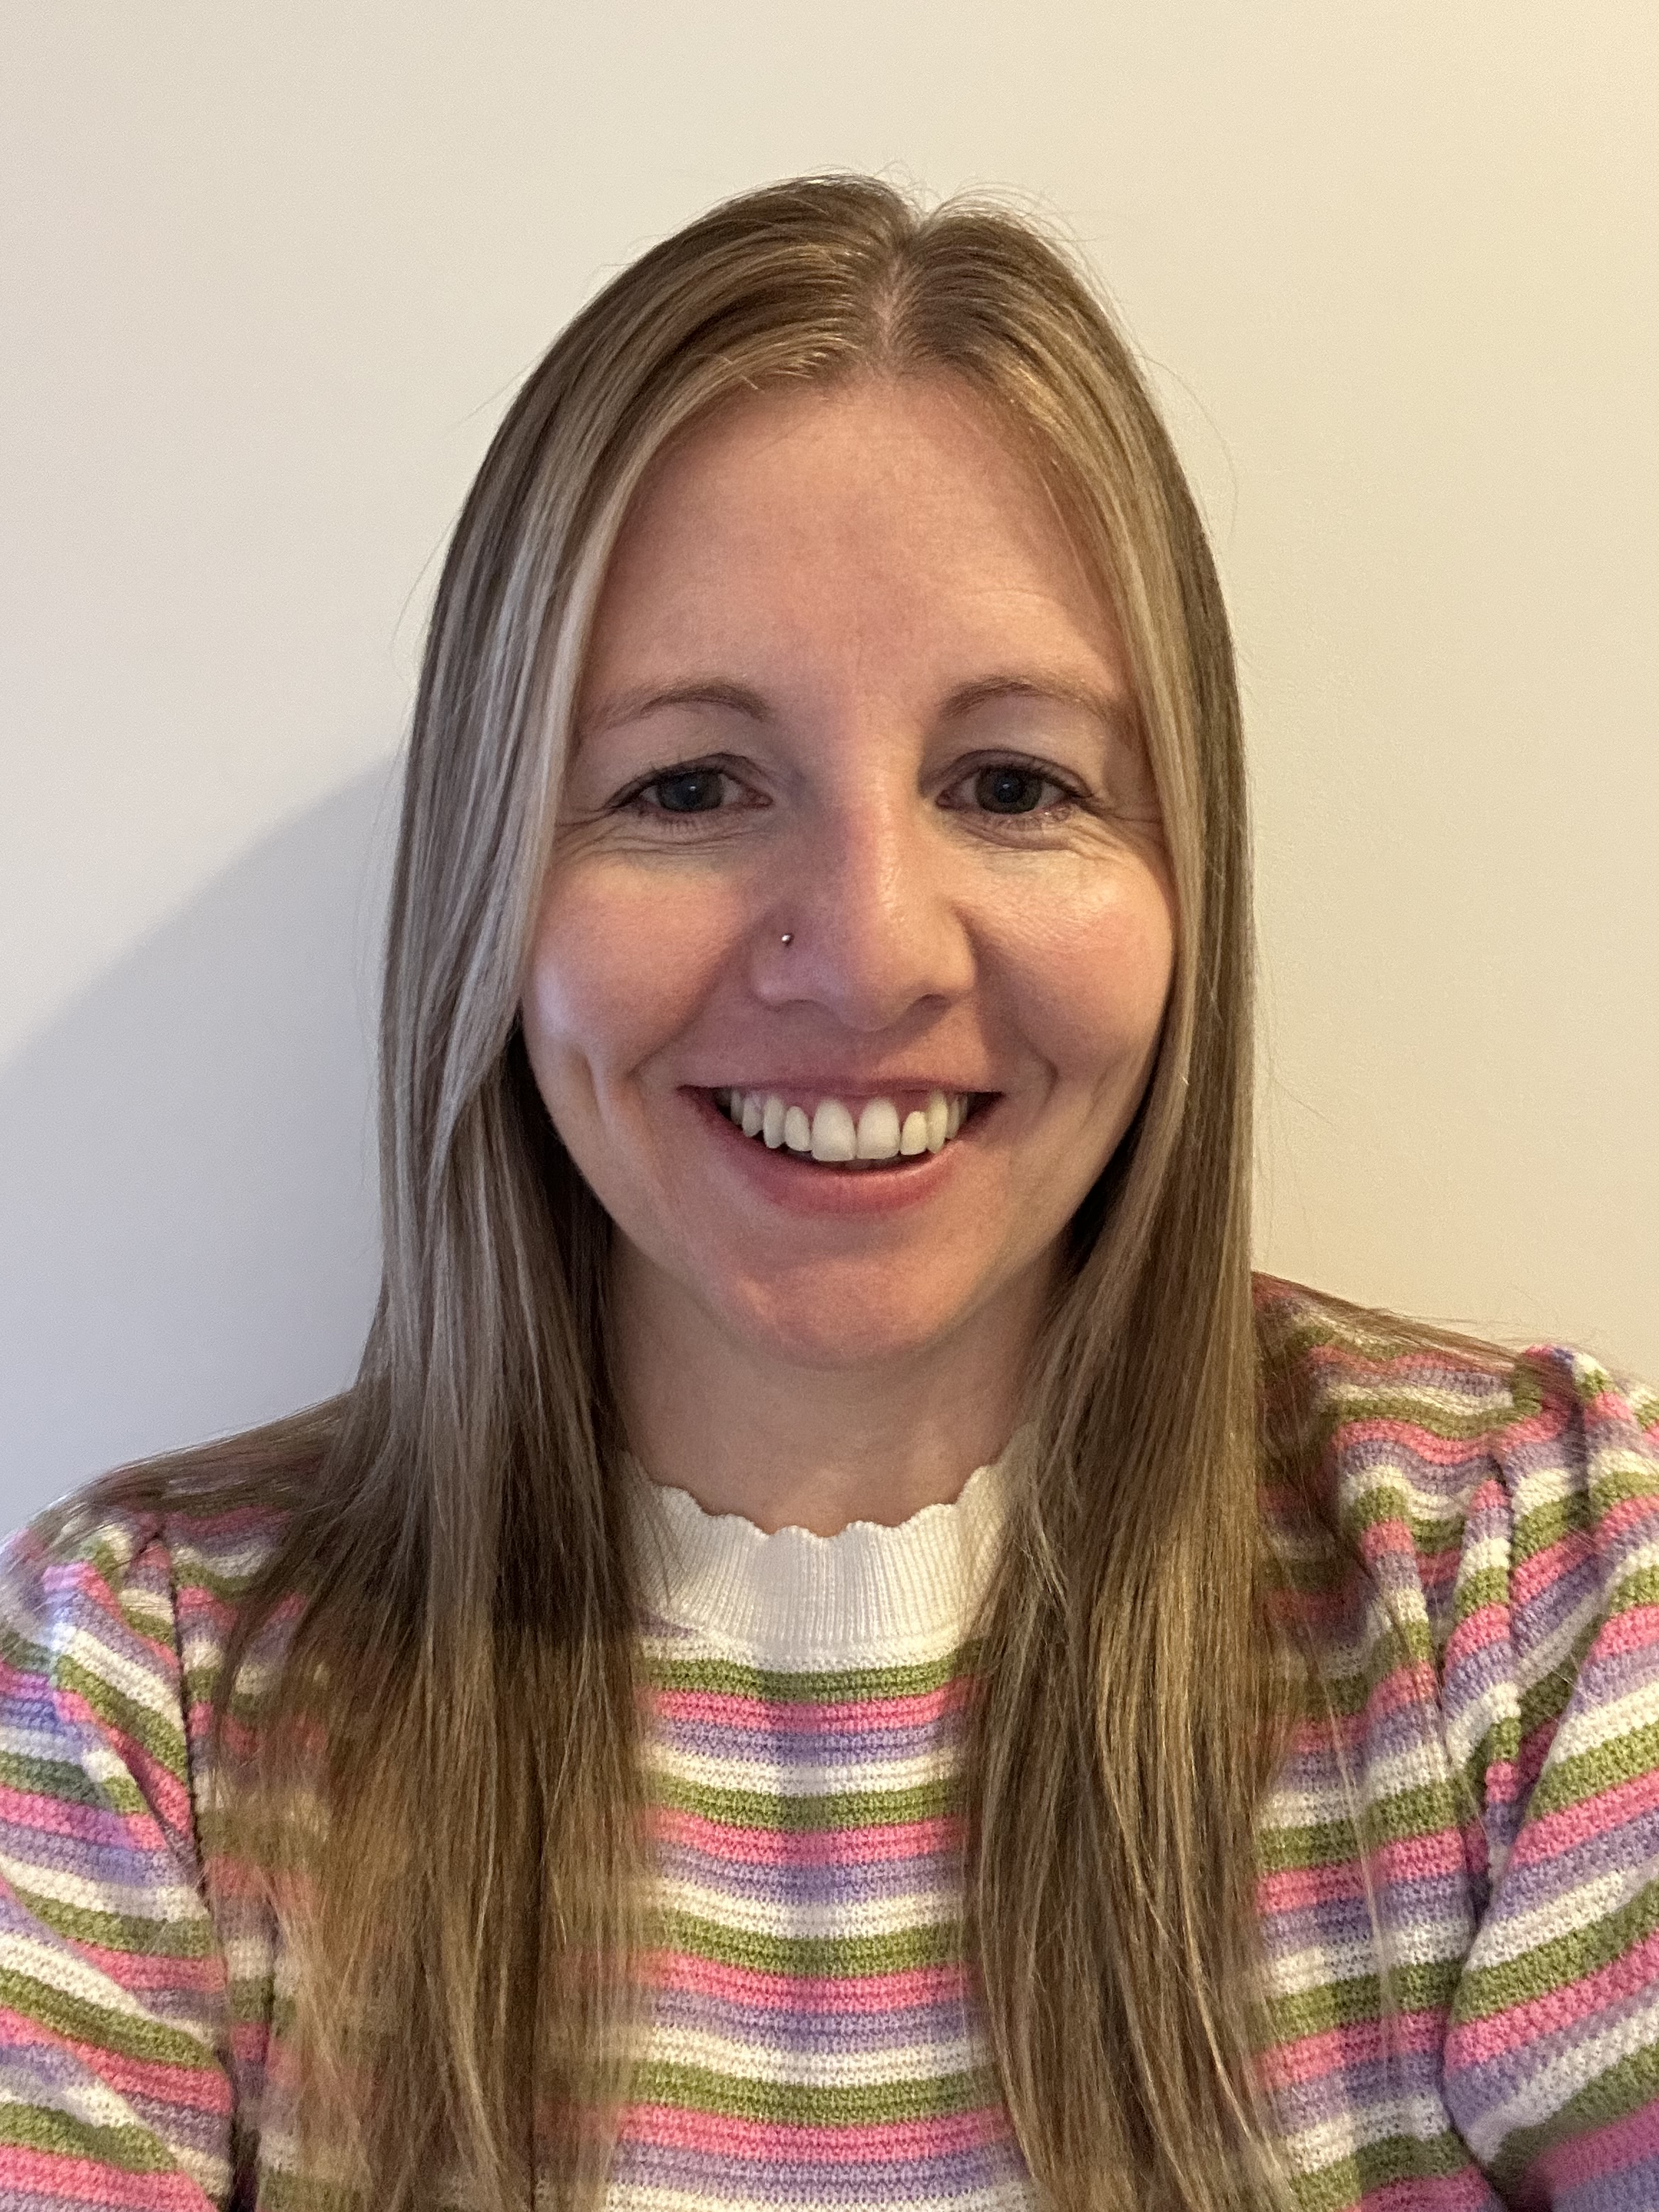
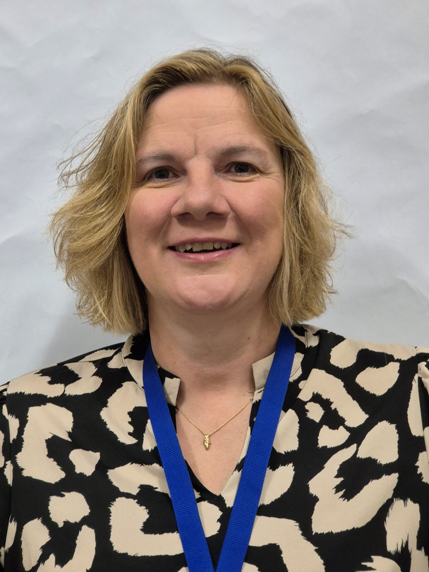

Staff you will see….
Mrs Jacobs
Assistant Head Teacher
Miss Moore
Deputy Head Teacher
Mrs Ryder-Smith
Head Teacher
Mrs Mitchell
Assistant Head Teacher
Mrs Compton
SENDCo and
Assistant Head Teacher

Slide 4
Who Do I speak to?
Class Teacher – year group email/drop off and pick ups
Inclusion Team – Mrs Wardle and Miss Adkin
SENDco – email the office/post sent to office

Slide 5
Routines….
Clothing
Please label all clothing
There are already lots of un-named jumpers in lost property!
Please have a look through the pile before you leave if you’re missing one!

Slide 6
Routines….
Drinks
Water only please in a labelled bottle.

Slide 7
Routines….
Coats
Please send your child with a coat (labelled!) when the weather is colder/wetter – we try to keep play time outside as much as possible!

Slide 8
Routines….
Reading
In school every day, in their reading folders,
RWI Zippy Wallets
1x coloured RWI book
1x black and white RWI book
Changed on Thursday, returned on Friday
1x sharing book
Reading log
Please read with your child at least 3 x per week.

Slide 9
Routines….
Numbots
Please use Numbots to practice basic number skills at home.

Slide 10
Routines….
PE
Outdoor PE
(Mondays) Tuesdays
PE kit needed
Shorts and t-shirt
Warm jumpers/tracksuits recommended for colder weather
Indoor PE
Thursdays
PE kit needed
Shorts and t-shirt

Slide 11
Routines….
  Dinners
If booking dinners on Relish, please make sure you have selected all of the options!

Slide 12
Topics covered this year….
Seasonal changes (science)
School locality – our village (geography)
Colour (art)
Walter Tull (history)
Animals including humans - senses (science)
Remembrance (history)
Life in the U.K. (geography)
Puppets (D.T.)
Changes in recent memory (history)
Oceans and seas (geography)
Line (art)
Everyday materials (science)
Parliament and royalty (history)
Plants (science)
Animals (science)
George Stephenson (history)
Seasonal changes (science)
Windmills (D.T.)
Hot and cold places (geography)
Portrait and artist study (art)
Smoothies (D.T.)

Slide 13
Extra Special Info…
Phonics screening in June (straight after half term)
Children will read 40 ‘real’ and ‘alien’ words. Focus on decoding using phonics. We will report your child’s result to you in your child’s school report.

Slide 14
Resources in your child’s pack
Letter and number formation
Common exception words
Number bonds
100 square
Reading questions and strategies
Year 1 spelling words
RWI sound mat
Numbots information and log in information

Slide 15
Finally….
If you have any questions or concerns, please come and speak to us!
☺
Year1@ccsp.risemat.co.uk

