Slide 1

Welcome
Phonics Screening Check

Slide 2
What is the phonics screening check?
The phonics screening check is an informal test that pupils take in Year 1 and sometimes Year 2. It tests them on their ability to read and decode a series of words.

Slide 3

What does it look like and what will they have to do?
Your child will sit 1:1 with their teacher and be asked to read the words as they work through the booklet.
The teacher will mark what they say on a separate sheet.
There will be a mixture of real words and alien words.

Slide 4

When do the children do it?
The checks will be completed on the week of
Monday 8th June 2026.

Slide 5

How is it scored?
The pass mark does not get released until a few weeks after the phonics screening checks have been completed.
(Most years the pass mark has been 32/40)

Slide 6

How do parents find out the result?
Teachers will score the children whilst they are doing the check, however we are NOT allowed to discuss your child’s score.
Parents/carers will receive a letter towards the end of the academic year. The letter will tell you your child’s score and say whether they have passed the check or not.

Slide 7
What happens if my child does not pass the phonics screening check?
Children who do not pass their phonics screening check will be required to retake the check next year, when the next cohort take their screening check (in Year 2).

Slide 8

How can I help my child prepare?
Read with your child as much as possible …don’t leave this until the week before the check!
Encourage your child to use the following method with words they are not familiar with - ‘special friends, Fred talk, say the word’ . If they do this and the word does not sound like a real word, then try again by saying a different sound for that spelling. What else could it be?
Phonics play game- Picnic on Pluto
Introduce them to new words and the meaning of those words (this will help with distinguishing between alien and real words)
Practise the real and alien words we will be sending home after Easter.
Spot the ‘special friends’, add the sound buttons, Fred the word and say the word.
Sometimes children can read well but struggle with alien or unknown words

Slide 9
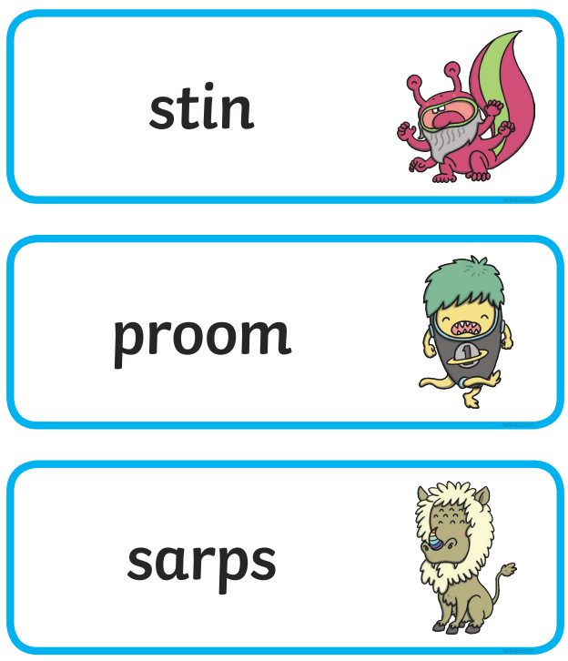
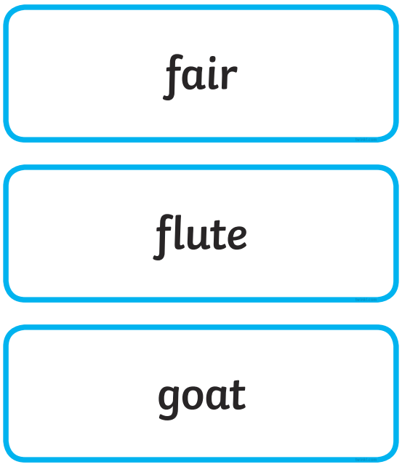
Spot the ‘special friends’, add the sound buttons, Fred the word and say the word.

Slide 10
You will notice that phonemes can be represented by different graphemes and graphemes can represent different phonemes. English is not easy!
or
for
poor
sore
raw
caught
ea
‘ea’ could be:
ee – like in sea and team
ay – great and break
e – like in head and bread

Slide 11

Any questions?
For more information follow the links below:
PSC oxford owl-
https://home.oxfordowl.co.uk/year-1-phonics-screening-check/#:~:text=The%20Year%201%20phonics%20screening,for%20pleasure%20and%20for%20learning.
What is the PSC- https://www.youtube.com/watch?v=rHZzKHeZ-oI
Gov.uk PSC parent info-
Phonics screening check: information for parents - GOV.UK
Please feel free to ask me any questions you have either now or in the future. ☺

